Slide 1
eXtreme Programming
Starting out with XP

Slide 2
Overview
The 6 essential practices
Dealing with process problems
Resistance when trying to introduce XP
XP and communication

Slide 3
The 6 essential practices when starting out with XP
Planning and estimating
Small releases (and iterations)
Testing first (unit testing)
Pair programming
Refactoring
Continuous integration

Slide 4
Dealing with process problems
Assume that XP practices will work; don’t plan for failure but deal with problems as they arise. Problems often quoted:
  How do you pair if odd number of developers?
  What if customers won’t write stories?
  What if customers won’t write acceptance tests?
  What if management refuses to set realistic delivery schedules?
  What if management doesn’t believe your estimates?
  What if management doesn’t let you pair program?

Slide 5
Process exceptions
Odd number of developers
  Assign maverick task to single programmer
  Tri-program at other times
Customer won’t write stories or acceptance tests
  You write initial first cut and get customer to verify and sign off
Unrealistic deadlines
  Break down stories into tasks and provide detailed estimates to back your case. Work elsewhere!
Your estimates aren’t accepted
  Ask them if they know something you don’t
Pair programming banned
  Call it something else, like mentoring

Slide 6
Manager resistance to XP
XP is too new to trust
  Is the status quo satisfactory?
  Try out on a small pilot project first
XP is too simplistic and naïve
  Other approaches deal with complexity through upfront guesswork
  XP is simple not simplistic, recognising need to support change. Planning game, pair programming, test focus all reduce risk. Complex documentation is not the answer

Slide 7
Manager resistance to XP (2)
Pair programming is too expensive
  Development time does increase by 15% but
  Costs offset by increased design/code quality, reduced defects, non-reliance on stars, continual review. Otherwise need “safety net” of documentation for lower quality code
Can’t afford full-time onsite customer
  They provide essential information wrt requirements
  Without rapid feedback project slows and developers guess
XP is too informal
  Lots of documents don’t improve code
  Good design and coding practices do

Slide 8
Developer resistance to XP
XP is too simplistic
  Developers experienced doing development in some other, complex way and feel threatened
Won’t like pair programming
  Sharing the glory
  It’s a new way of working
  90% of those who try it like it
  Code reviews are most effective contributor to quality so continual pair review should be very effective

Slide 9
Developer resistance to XP (2)
XP is strange
  Writing tests before code
  Design evolves to fit changing requirements
  Programming in pairs
XP doesn’t provide enough information
  XP provides essential documentation: prioritised stories, acceptance and unit tests, the code (AM goes a bit further)
  Provides information verbally

Slide 10
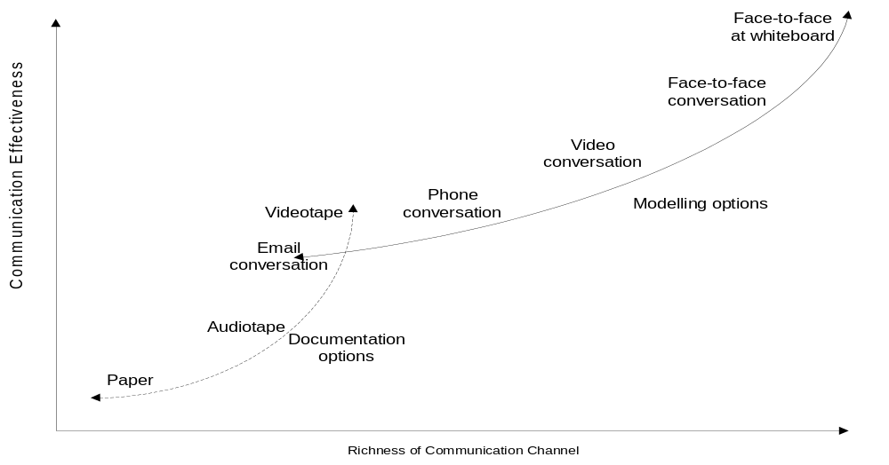
XP and communication
“Don’t write if you can just talk
Don’t talk if you can just point
Don’t point if you can just do
And know when you can’t” Ward Cunningham, 2001
XP makes not communicating unnatural

Slide 11
Pair programming and communication
Documentation is replaced with oral history and communication
Disseminating information through the “pair vine”
Documentation in reality tends to be out-of-sync with the actual system
Keeping documents in sync is expensive and unpopular

Slide 12
Stand-up meetings
15 minutes meeting every morning
  Identify trouble spots
  Identify who might be able to help
  Communicate surprises to exploit or prepare for
  Motivational
For each person:
  Summarise what did yesterday that might impact group
  Progress made yesterday
  Plans for today

Slide 13
Planning and communication
Heavyweight processes develop complex task lists, dependencies and milestones
They often fail to convey information to developers
Planning in XP requires constant communication based around story card estimation and prioritisation

Slide 14
Communication and the project environment
Open-plan without partitions
  Pick-up on problems
  Easy to ask questions
  Rapid communication of a problem
  Space to pair is essential
Lots of whiteboards and access to a large desk
  Shared public models (from AM)
  AM’s has principle of using simplest tools. Index cards and whiteboards are examples. Desk for spreading cards

